Slide 1



SATNOGS-GDN
Satellite Ground Station in Gdańsk
Sławomir Figiel Tomasz Mrugalski Ewelina Omernik
Space and Satellite Technologies
9 January 2020

Slide 2

Long term objective:
Help building Polish space ecosystem by providing data downlink service
Project goals:
Design, implementation and operation of a ground station
Omnidirectional antenna (fixed)
UHF or VHF bandwidth
SDR (Software Defined Radio)
Embedded platform (Raspberry Pi)

Slide 3

Architecture
Problems solved
SDR
DSP CPU
content
server
Internet
antenna
Hardware (band, SDR, antenna, LNA, computing platform, …)
UHF or VHF bandwidth
Location (antenna installation, cabling)
Software configuration
Automation
Results visualization

Slide 4
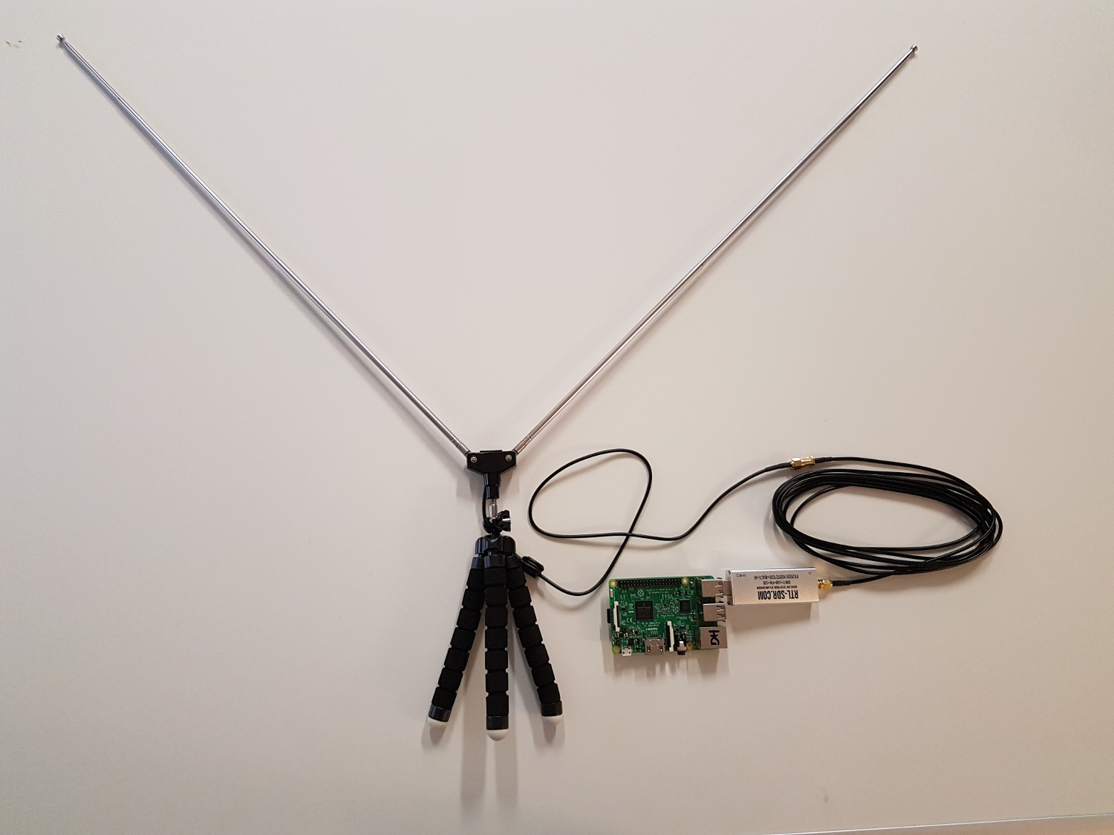
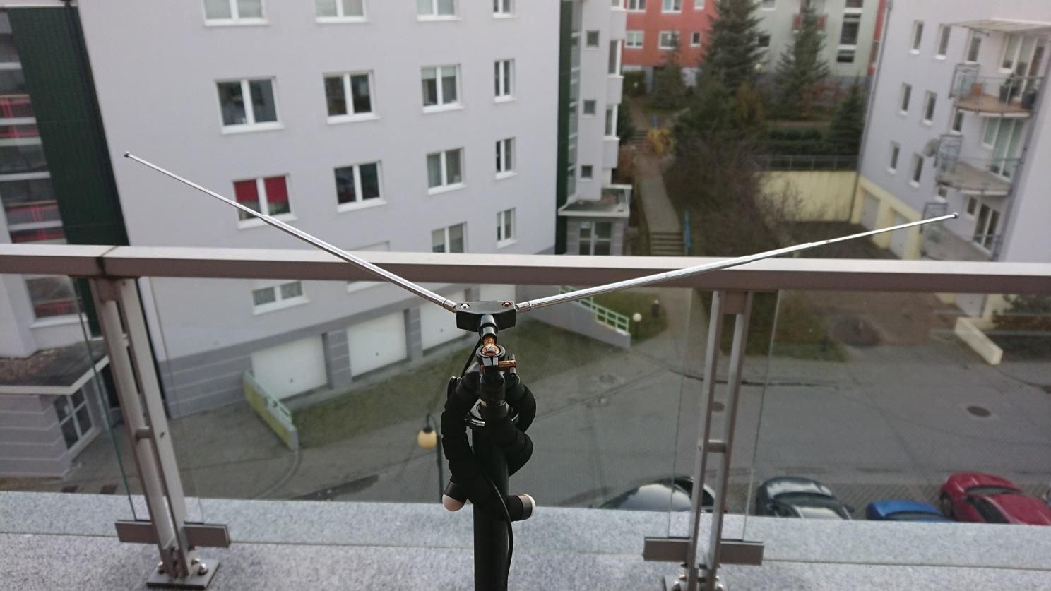
Antenna v1

Slide 5
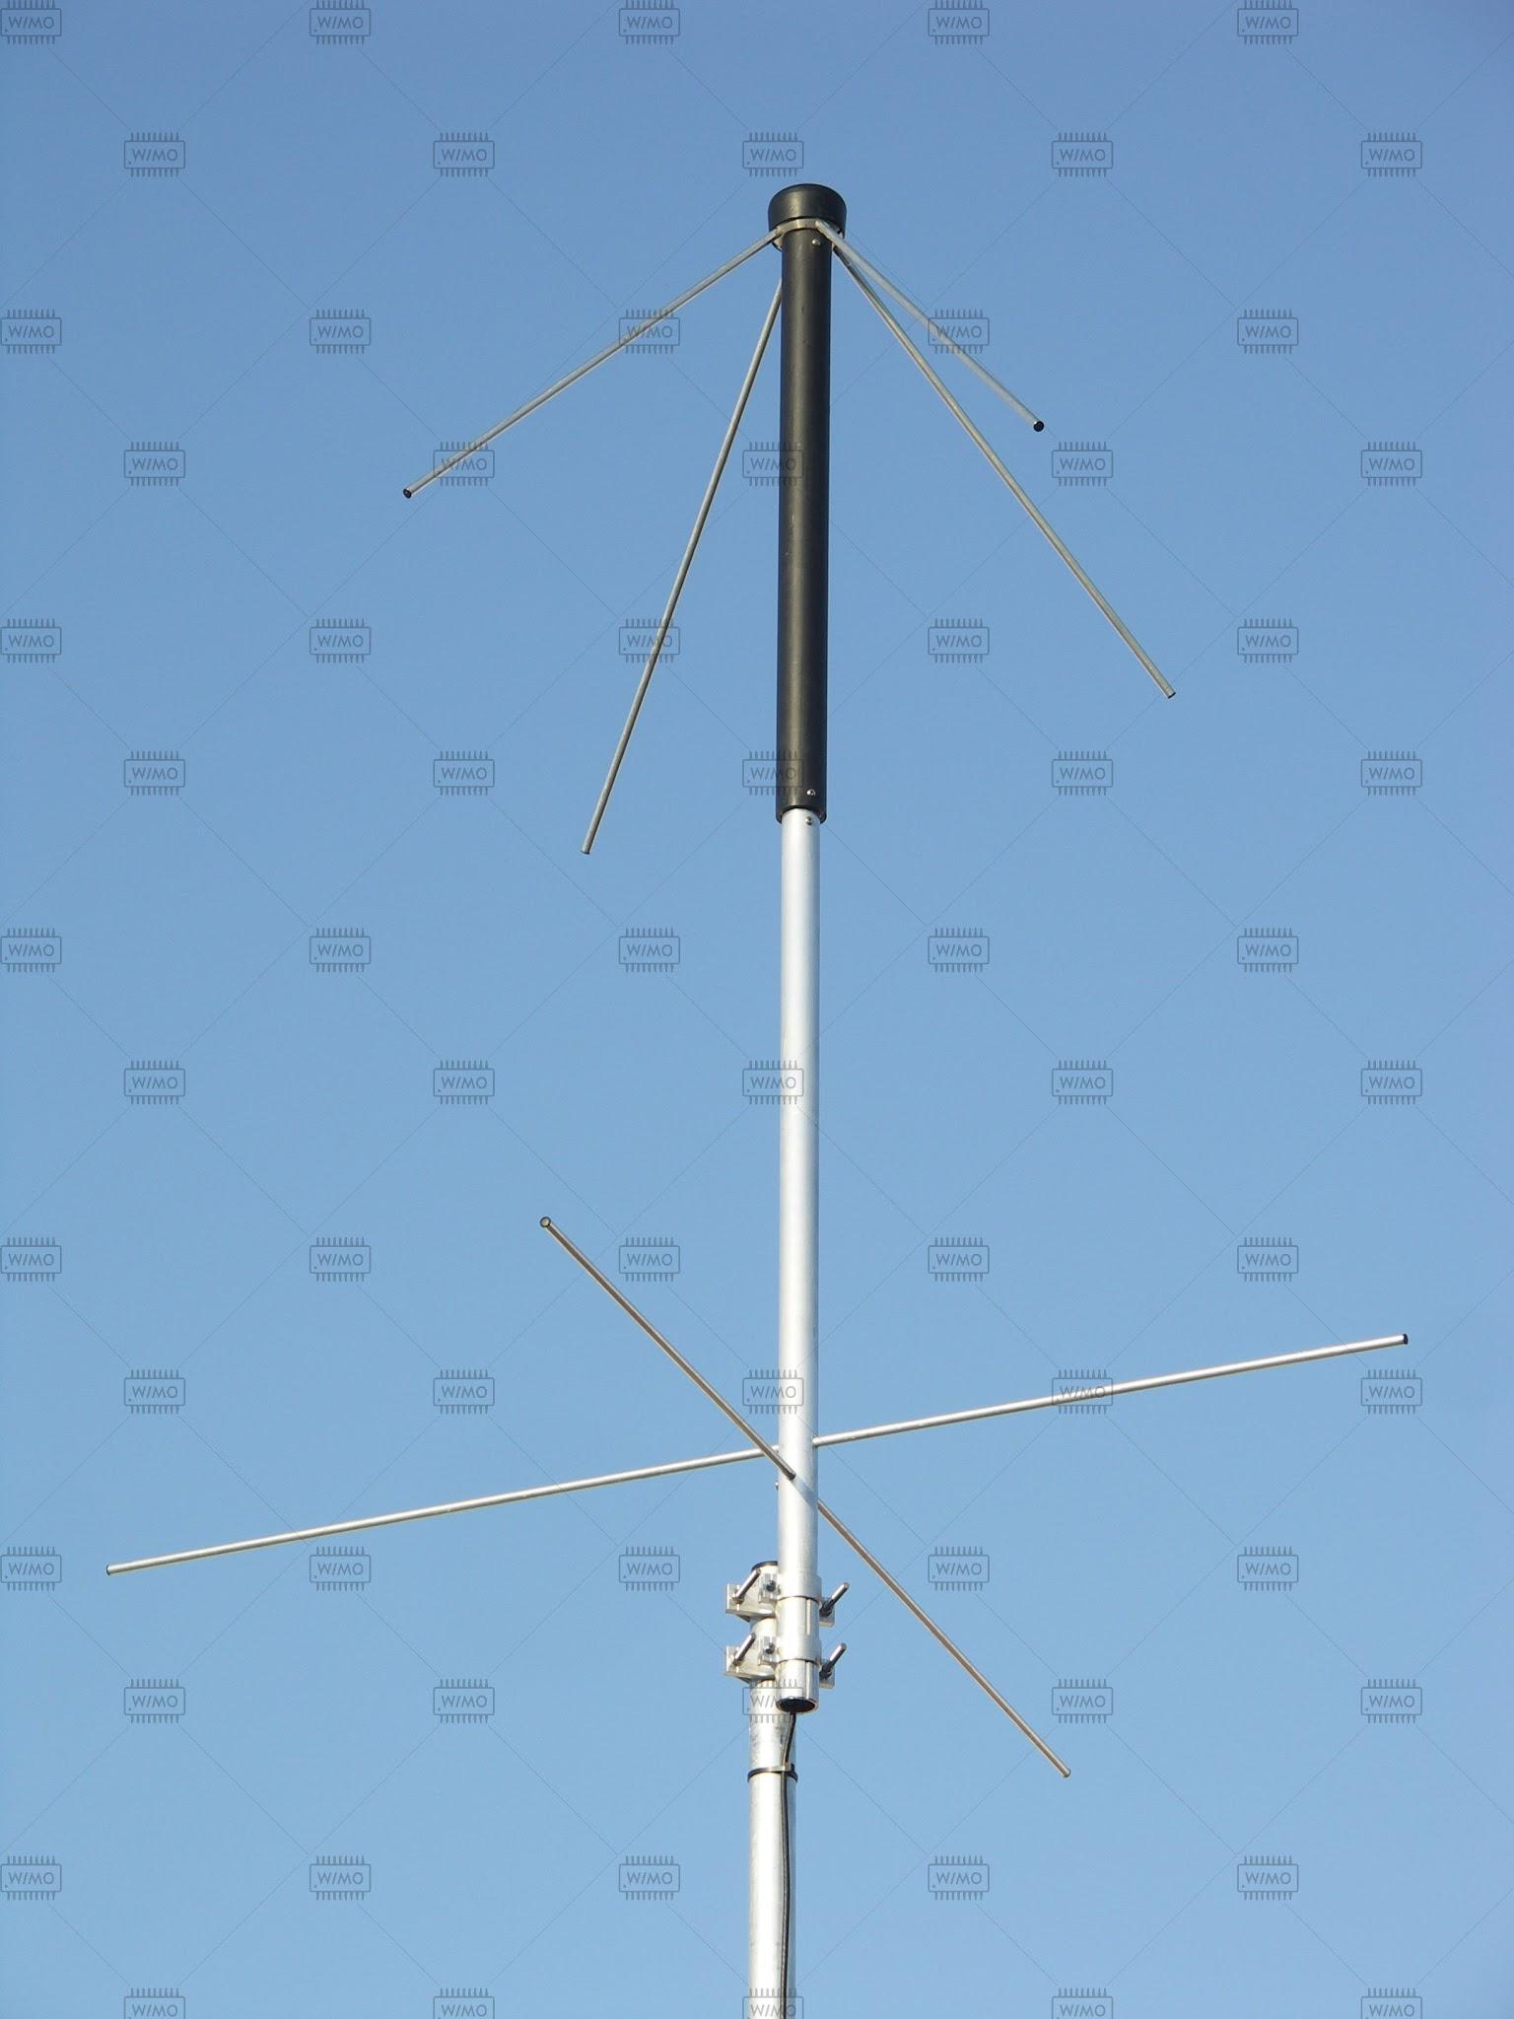
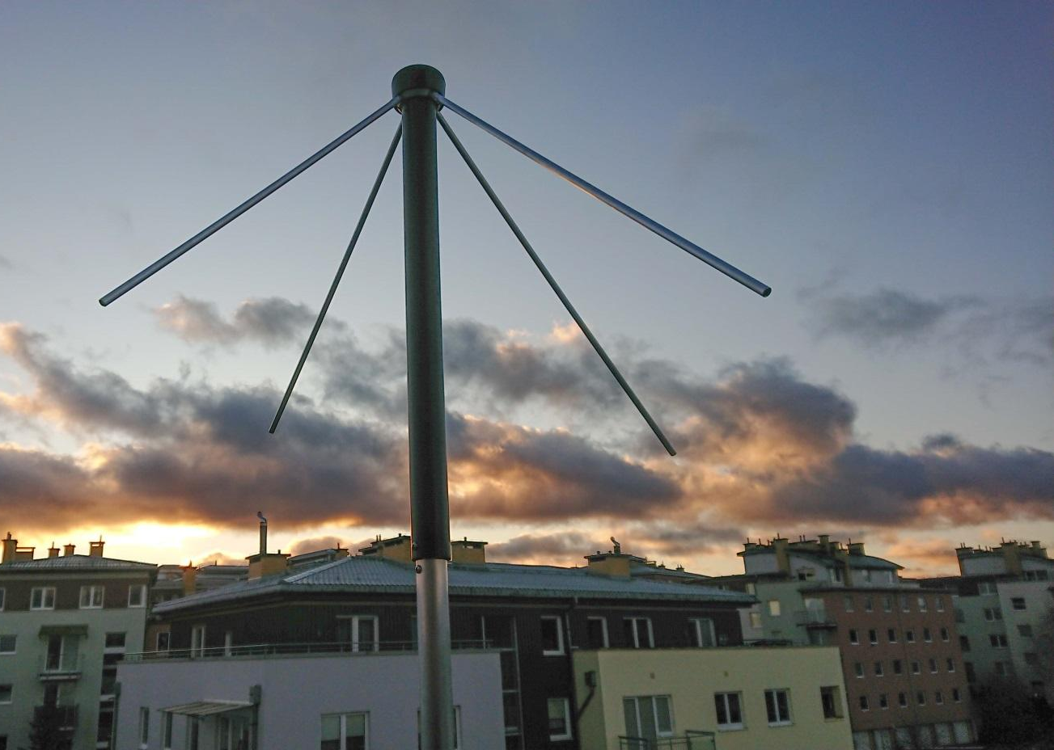
Antenna v2 - TA-1 Turnstile

Slide 6
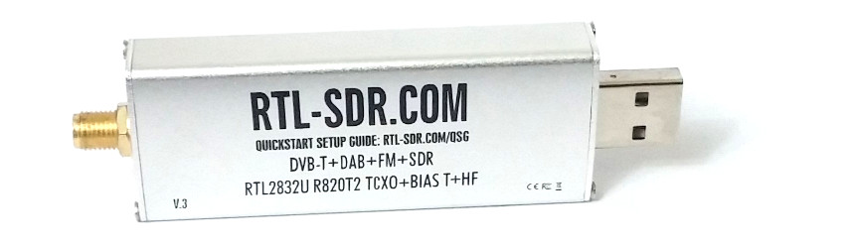
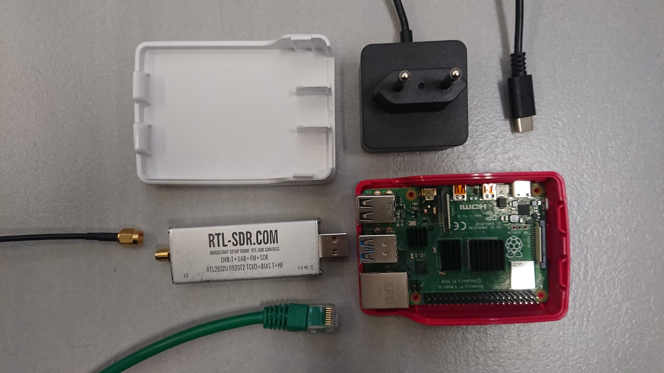
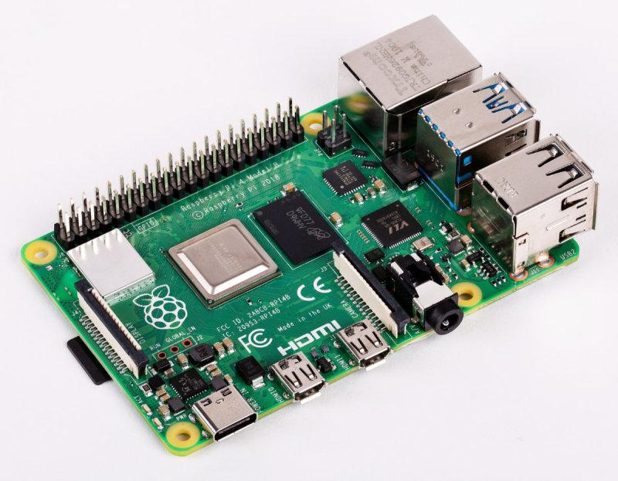
SDR + RPi

Slide 7
How to receive a sat transmission in 5 easy steps

Slide 8
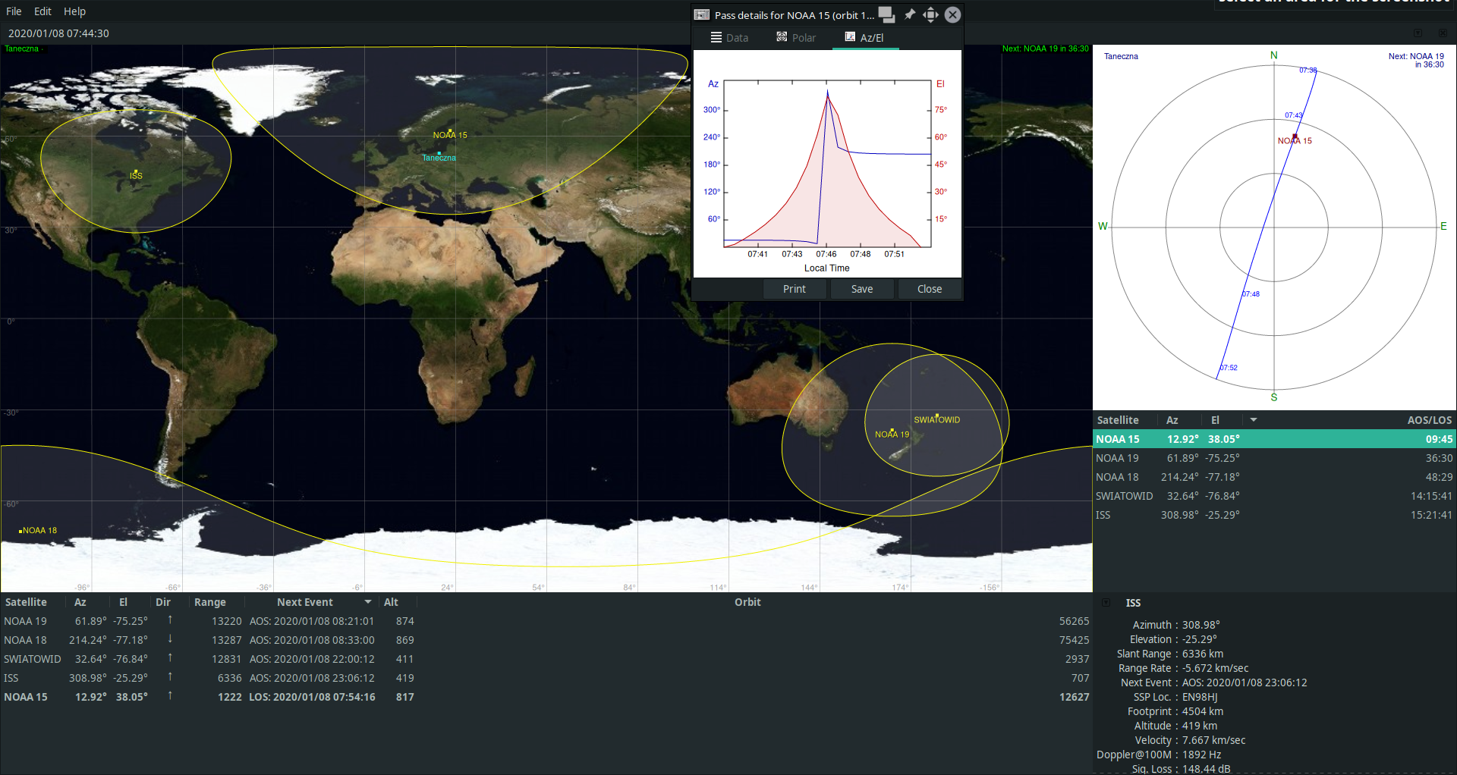
Step 1: Predict satellite fly-over

Slide 9
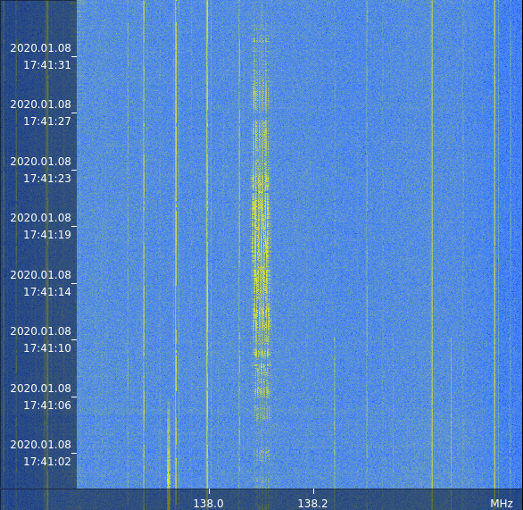
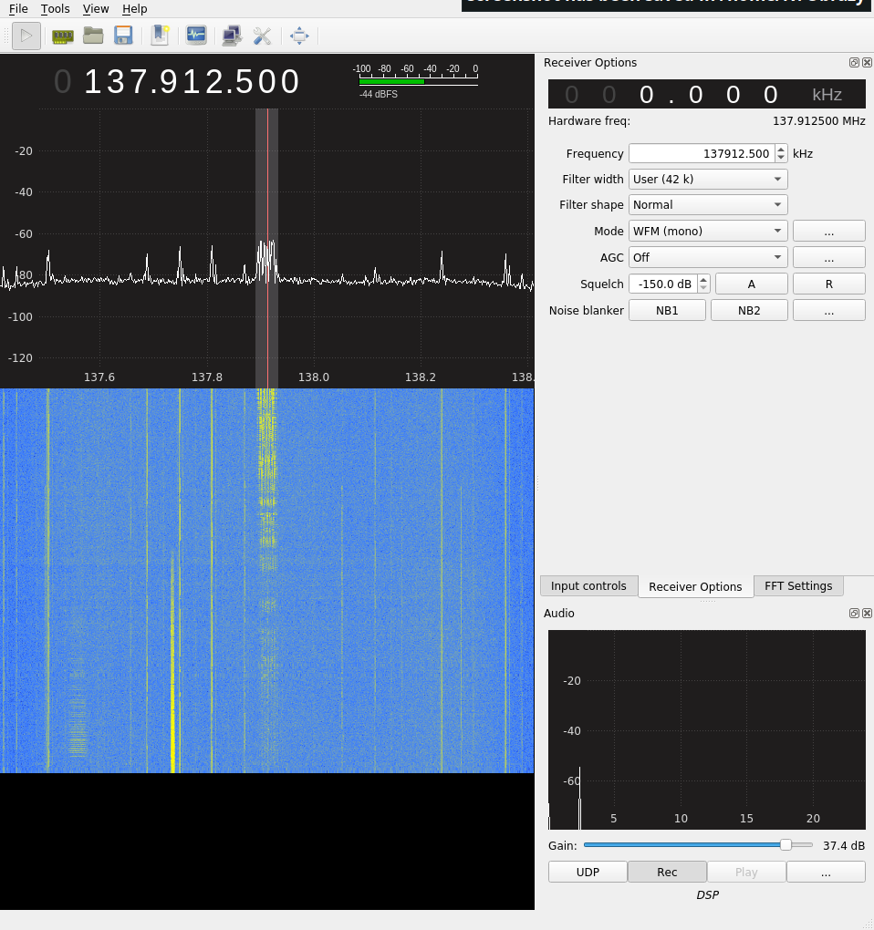
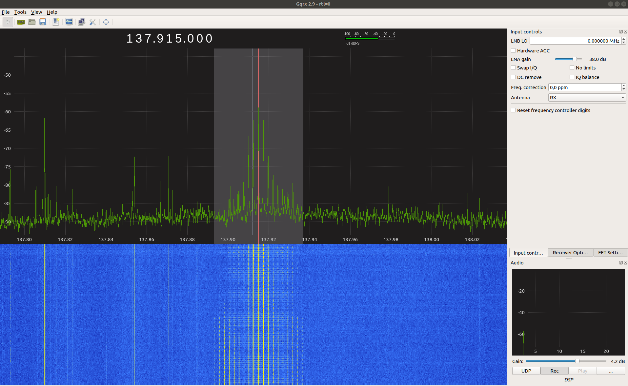
Step 2: Tune SDR to transmission frequency

Slide 10
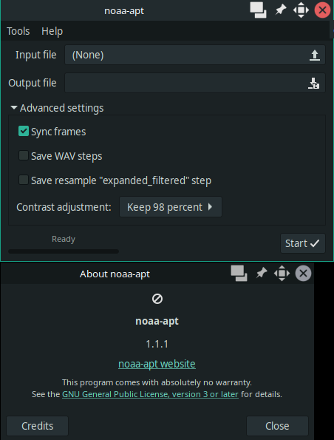
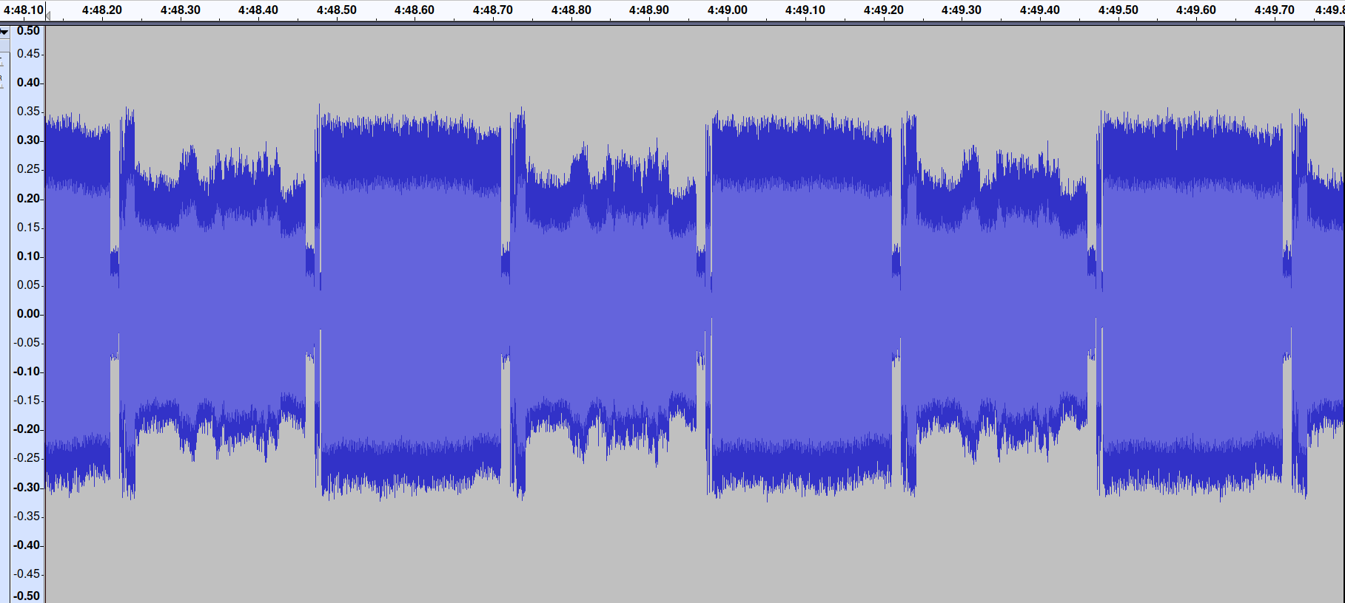
Step 3: Decode transmission

Slide 11
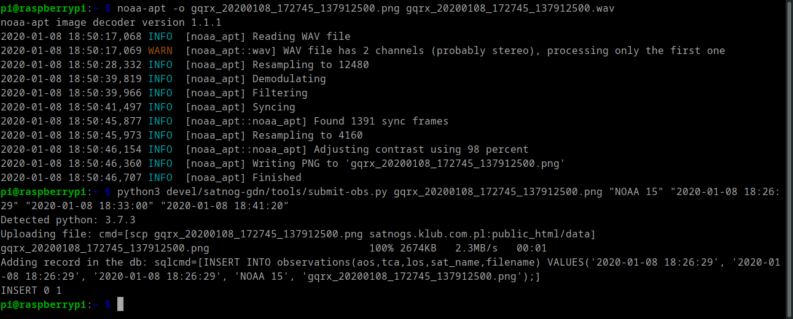
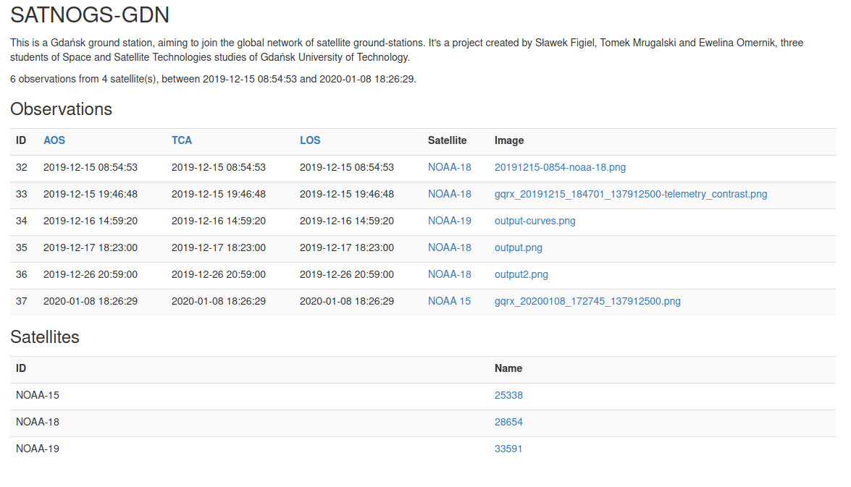
Step 4: Upload to content server

Slide 12
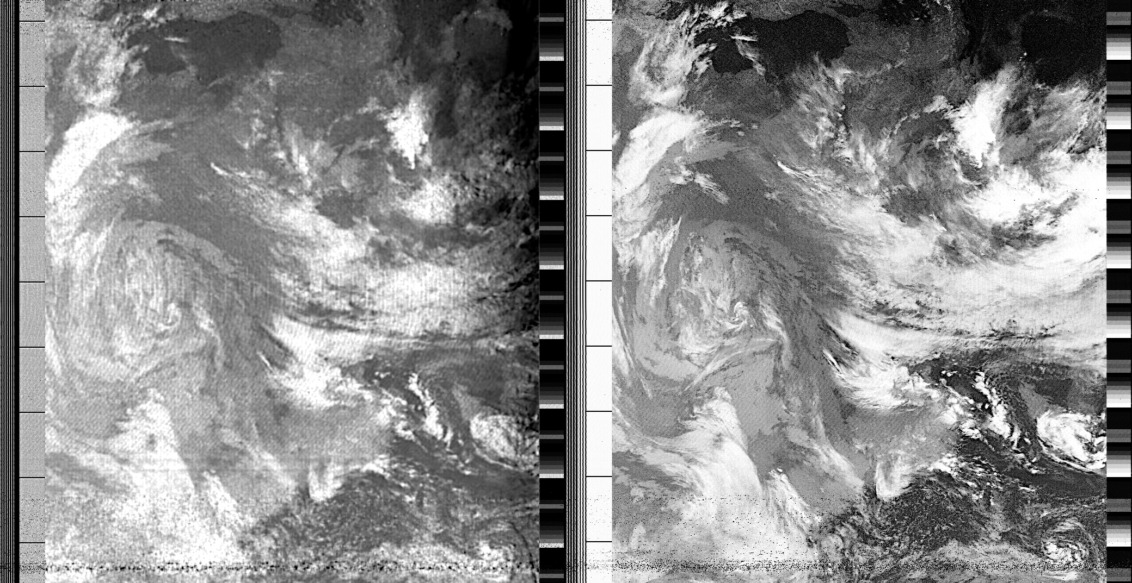
Step 5: Profit!

Slide 13
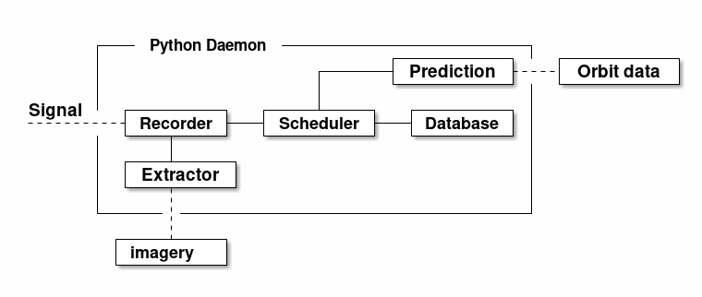
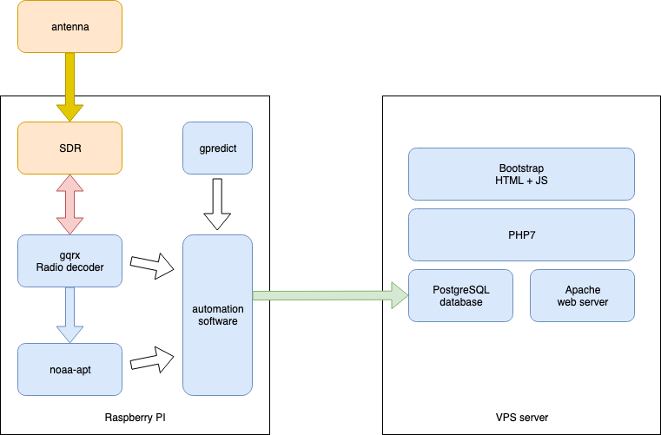
Automation
Realization
Concept

Slide 14
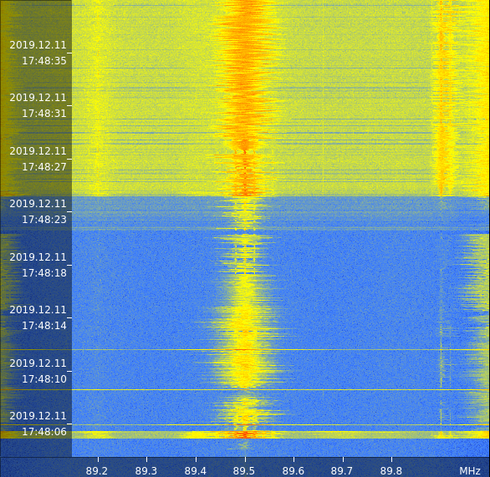
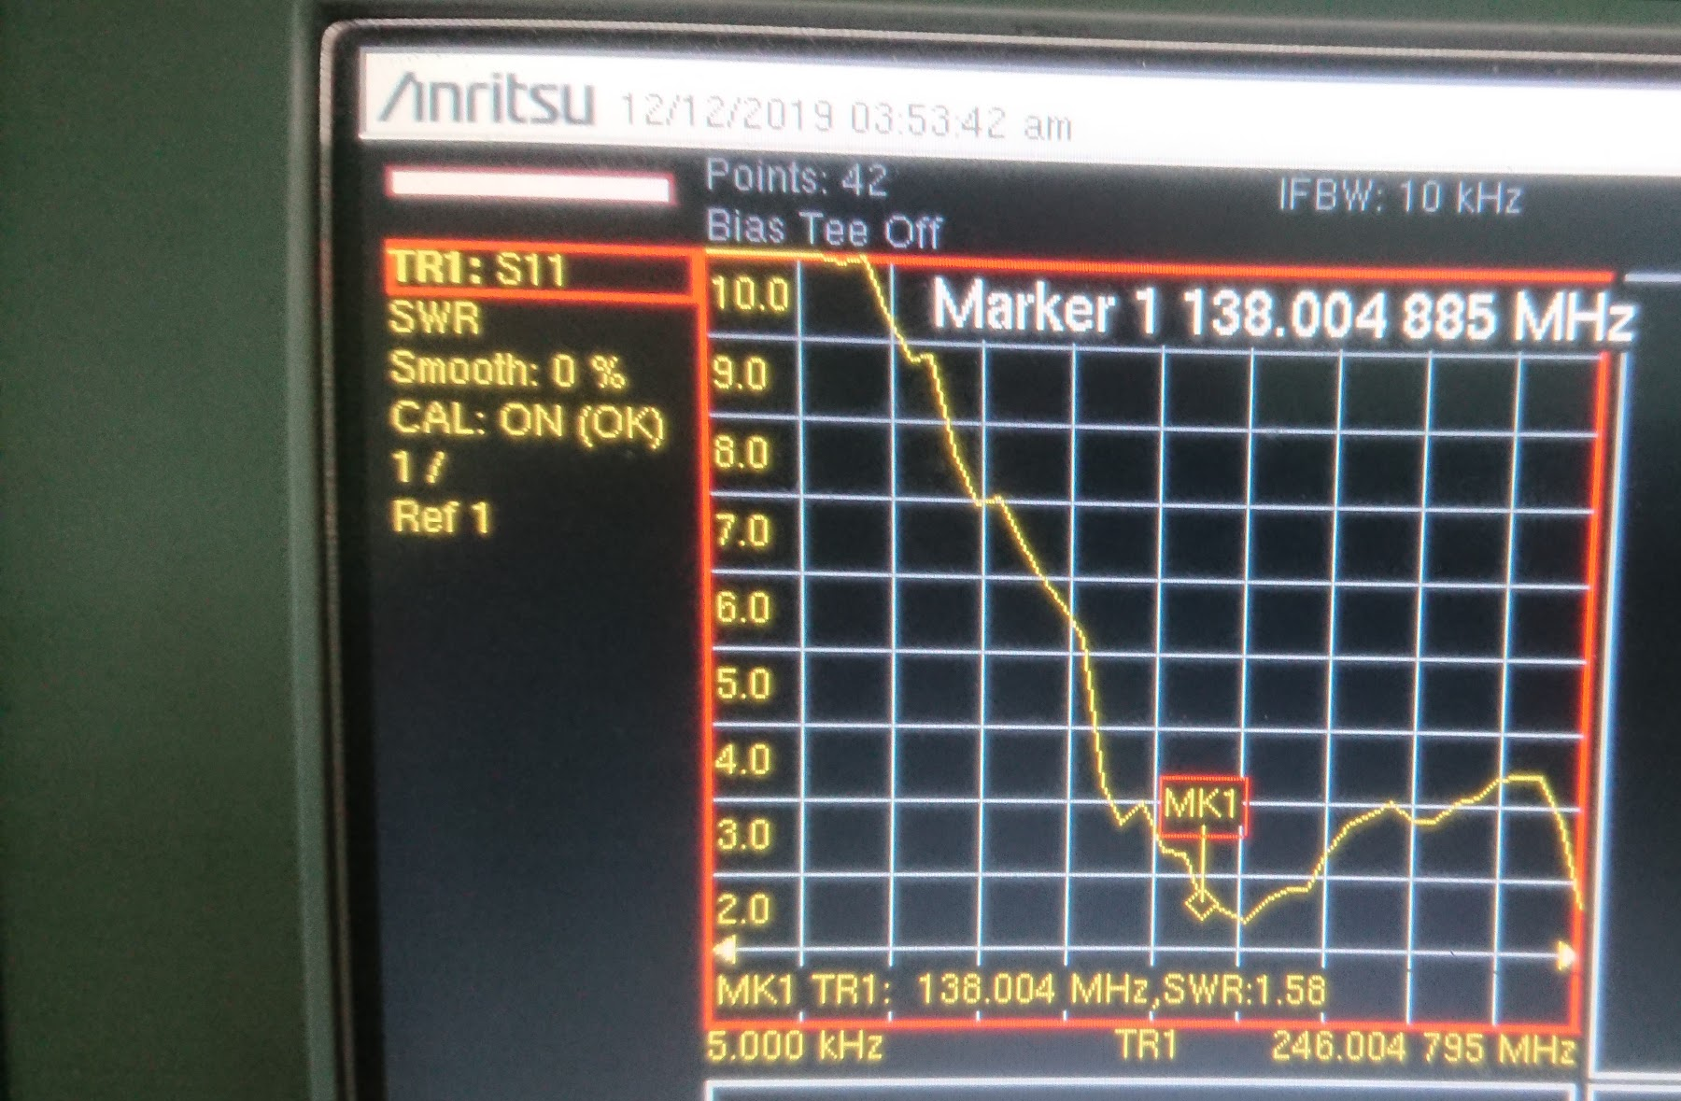
Troubleshooting
SWR measurements
Broken new antenna
Prototype antenna

Slide 15
Next steps
Better code and web interface
Connect to SATNOG network
Switch to directional antenna
Switch to UHF and S band
Cooperation with amateur Cubesat projects

Slide 16

Q&A
https://satnogs.klub.com.pl/

